Slide 1
Nutrition in Plants
Chapter 7

Slide 2
Learning Objectives
State the equation, in words and symbols, for photosynthesis.
State the essential conditions of photosynthesis.
Describe the process of photosynthesis.
light-dependent and light-independent stages
Discuss the limiting factors and the effect of varying them on the rate of photosynthesis.
Identify and label the cellular and tissue structures of a dicotyledonous leaf as seen in the cross-section under the microscope.
Discuss the adaptations of the leaf for photosynthesis.
Describe the significance of the external and internal features in terms of their function.
distribution of chloroplasts for photosynthesis, stomata and mesophyll cells for diffusion in gaseous exchange and the vascular bundle for transport.
Outline the intake of carbon dioxide and water.

Slide 3
Types of Nutrition
Animals –
Unable to manufacture their own food and obtain organic food substances by feeding on other organisms
Example: holozoic nutrition
Plants –
Builds up complex organic molecules from simple molecules
Using light energy (photoautotrophs)
Using energy from chemical reactions (chemoautotrophs)
Heterotrophic
Autotrophic
Notes:
Ask them what are the stages of holozoic nutrition – ingestion, digestion, absorption, assimilation

Slide 4
Photosynthesis

Slide 5
Where do plants get their food?
Photosynthesis

Slide 6
Definition of Photosynthesis
Photosynthesis is the multi-step process in which light energy absorbed by chlorophyll is transformed into chemical energy, which is used to synthesise carbohydrates from water and carbon dioxide. Oxygen is released during the process.

Slide 7
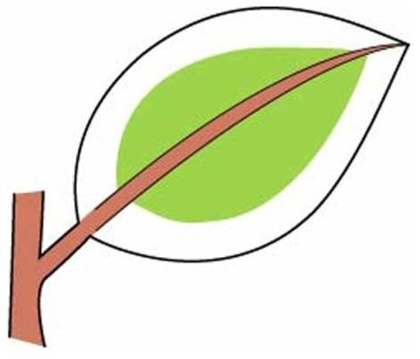
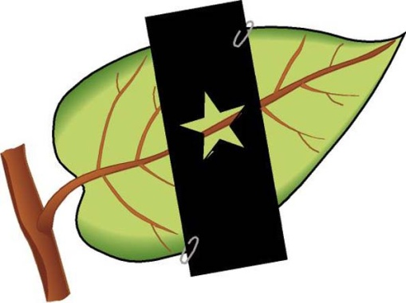
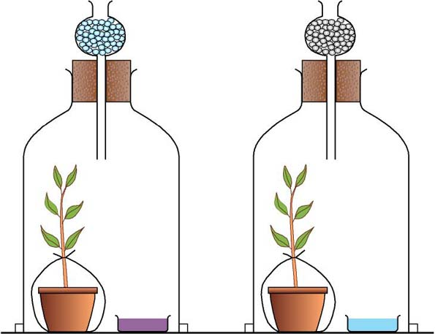
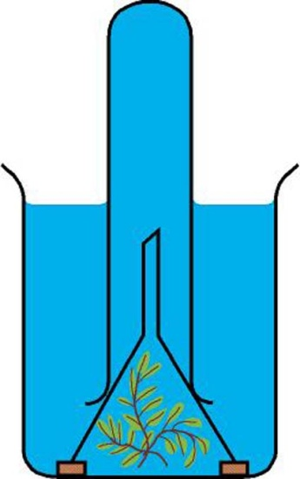
Study of Photosynthesis
Test for
Starch
Test for
Sunlight
Pg 115
Test for
Chlorophyll
Pg 116
Pg 116
Test for
Carbon
Dioxide
Test for Oxygen produced
Pg 117
Pg 117
Notes:
Break class into 4 groups during Thurs period (10mins), then present during Friday class.

Slide 8
Study of Photosynthesis – Test for Starch
Procedure:
Use a green leaf from a plant that has been exposed to sunlight for a few hours
Put the leaf in boiling water for 2 minutes.
Transfer the leaf to a boiling tube containing some alcohol and place the boiling tube in a beaker of hot water for 10 minutes
Gently remove the brittle leaf and put it back into hot water to soften the leaf.
Add a few drops of iodine solution to the leaf

Slide 9
Essential Conditions for Photosynthesis
To produce starch in leaves, we need:
Light energy (Sunlight)
Carbon Dioxide
Chlorophyll
Water
Suitable Temperature

Slide 10
Equation for Photosynthesis
Light energy
Chlorophyll
Carbon dioxide + Water Glucose + Oxygen + Water
CO₂ + H₂O C₆H₁₂O₆ + O₂ + H₂O
Light energy
Chlorophyll

Slide 11
Stages of Photosynthesis
Photosynthesis occurs in the light-dependent stage (light stage) and the light-independent stage (dark stage)

Slide 12
Stages of Photosynthesis – Light-dependent Stage
Light energy is absorbed by chlorophyll and converted into chemical energy.
Light energy is used to split water molecules into oxygen and hydrogen atoms. (Photolysis of water)
12 H₂O 6 O₂ + 24 H

Slide 13
Stages of Photosynthesis – Light-independent Stage
Hydrogen (from photolysis) is used to reduce carbon dioxide to carbohydrates, such as glucose.
Energy required is from the light stage.
Enzymes control the reactions in the light-independent stage.
6 CO₂ C₆H₁₂O₆ + 6 H₂O 24 H (from light-dependent stage)

Slide 14
Absorption Spectrum
Different wavelengths of light are absorbed by chlorophyll during photosynthesis
Sunlight consists of a spectrum of light, and each colour has a different wavelength
Chlorophyll absorbs some wavelengths (mainly in the red and blue regions) while reflecting others (green light)

Slide 15
Absorption Spectrum (cont)
Absorption spectrum: extent to which different wavelengths of light are absorbed
Action spectrum: rate of photosynthesis

Slide 16
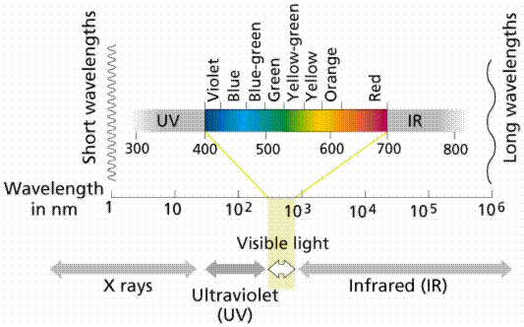
Light

Slide 17
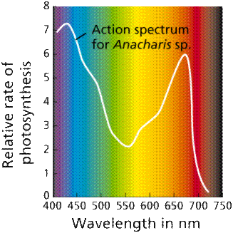
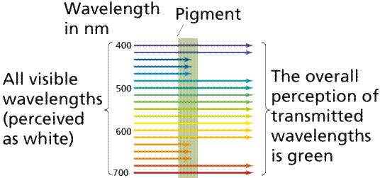
Light Absorption Spectrum
Why leave looked green?

Slide 18
Limiting Factors
(Recap) Limiting factor: any factor that directly affects a process and changes its quantity.
- Light intensity
- Concentration of carbon dioxide
- Temperature
Notes:
Remember enzymes. Intend to go through exp 7.6-7.8 here by

Slide 19
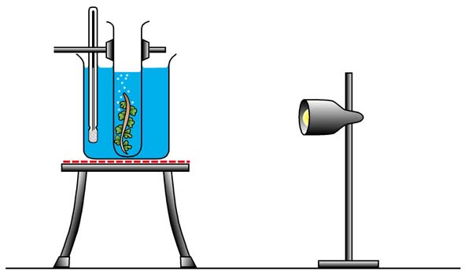
Limiting Factors – Light Intensity
Set up apparatus as shown with
cut end of plant facing upwards
Air bubbles will be given off from the cut end of the plant
When bubbles are produced at a regular rate (allow some time for the plant to adapt to conditions provided), count the number of bubbles over a period of 5 minutes
Repeat the count with the light source closer to the plant, and record your results in a table

Slide 20
Limiting Factors – Concentration of Carbon dioxide
Set up apparatus as seen in the experiment to investigate light intensity.
Use different concentrations of sodium hydrogencarbonate solutions (0.01M, 0.02M, etc.) which are proportional to carbon dioxide concentration in solution
Remember to keep the rest of the conditions constant eg. light intensity, temperature

Slide 21
Limiting Factors - Temperature
Explanation: Enzymes in the plant is denatured, causing photosynthesis to stop. Thus, oxygen is not released.
Set up apparatus as seen in the experiment to investigate light intensity.
To obtain different temperatures:
Add ice-cold water to the water bath to keep temperature at 5C
Repeat for different temperatures eg. 15C, 25C, 35C, etc by adding cold water to keep the temperature constant
Observation: Bubbles are not given off by the plant.
Question: What happens when the temperature is increased to 45C and beyond (optimum temperature)?

Slide 22
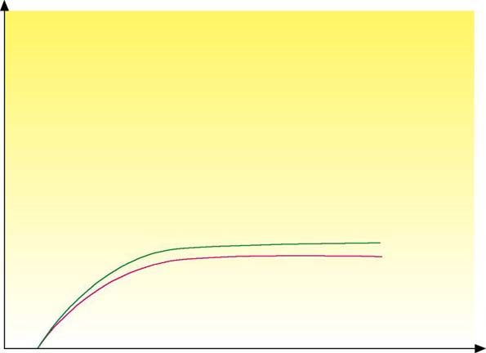
Limiting Factors – Graphs
Question: What is the limiting factor of the reaction before point A?
Rate of photosynthesis
Light intensity
0.03% CO₂ at 30°C
Question: What is the limiting factor of the reaction after
point A?
Graph 2
Graph 1
A
B
0.03% CO₂ at 20°C
Light Intensity
The carbon dioxide concentration

Slide 23
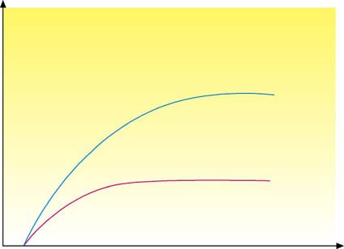
Limiting Factors – Graphs
Question: What is the limiting factor of the reaction from graph 1 and 3?
Rate of photosynthesis
Carbon dioxide concentration
0.13% CO₂ at 20°C
Graph 3
Question: Why is carbon dioxide an important limiting factor under natural conditions?
0.03% CO₂ at 20°C
Graph 1
A
B
The atmospheric carbon dioxide remains constant at about 0.03%
Light Intensity

Slide 24
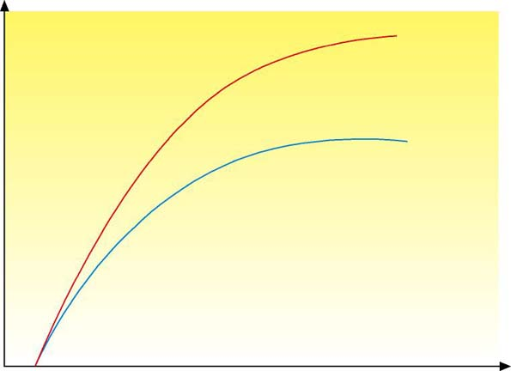
Limiting Factors – Graphs
Question: What is the limiting factor of the reaction from graph 3 and 4? Explain
0.13% CO₂ at 30°C
Graph 4
Rate of photosynthesis
0.13% CO₂ at 20°C
Graph 3
Temperature. Keeping the carbon dioxide concentration constant and increasing the temperature causes a large increase in the rate of photosynthesis.
F
E
Light Intensity

Slide 25
Compensation Point
At a certain light intensity,
The rate of photosynthesis equals to the rate of respiration. The amount of carbon dioxide taken in during photosynthesis is equal to the amount of carbon dioxide produced during respiration.

Slide 26
Fates of Glucose
Excess transported to other parts of plant for synthesis of new protoplasm & storage as proteins
Forms fats for storage, use in cellular respiration and for synthesis of new protoplasm
Proteins
used to
form
Reacts with nitrates and other mineral salts absorbed from soil to form amino acid in leaves
In daylight, excess
Glucose is converted into
Starch in
leaves
In darkness, starch
Is converted back into
Sucrose
Transported to storage
organs for storage as starch or in other forms
Used immediately – for respiration & form cellulose cell walls

Slide 27
Importance of Photosynthesis
Photosynthesis makes chemical energy available to animals
Sunlight → Plants → Animals
Photosynthesis removes carbon dioxide and provides oxygen
Energy is stored in coal through photosynthesis
Coal is formed from trees which contain a store of energy (starch) obtained from sunlight

Slide 28
Leaf Structure and Function

Slide 29
External Features of Leaf
Network of veins – carry water and mineral salts to the cells, and manufactured food from these cells to other parts of the plant.
Lamina – Large flat surface compared to its volume. Enables leaf to obtain maximum amount of sunlight. Thin lamina helps carbon dioxide to reach the inner cells of the leaf rapidly
Leaf arrangement – organised around the stem in a regular pattern. Either in pairs or singly in an alternate arrangement. Thus, leaves are not blocking one another from sunlight, receiving optimum light.
Petiole – holds the lamina away from the stem so that the lamina can obtain sufficient sunlight and air.

Slide 30
Adaptations for Photosynthesis
structure | function
petiole (leaf stalk) | holds leaf in position to absorb maximum light energy.
thin flat lamina | allows maximum absorption of light energy, allows carbon dioxide to reach inner cells rapidly. enables sunlight to reach all mesophyll cells.

Slide 31
Adaptations for Photosynthesis (cont)
structure | function
waxy cuticle on upper and lower epidermis | reduces water loss through evaporation from the leaf
stomata present in the epidermal layers | open in sunlight, allowing carbon dioxide to diffuse in and oxygen to diffuse out of the leaf
chloroplasts containing chlorophyll, in all mesophyll cells | chlorophyll absorbs and transforms light energy to chemical energy used in manufacture of sugar.

Slide 32
Adaptations for Photosynthesis (cont)
structure | function
more chloroplasts in upper palisade tissue | more light energy can be absorbed near the leaf surface.
interconnecting system of air spaces in the spongy mesophyll | allows rapid diffusion of carbon dioxide into mesophyll cells.
veins containing xylem and phloem | xylem transports water and dissolved mineral salts to mesophyll cells. phloem transports sugars away from the leaf.

Slide 33
Internal Structure of Lamina
cuticle
upper epidermis
chloroplast
palisade mesophyll
nucleus
xylem of vein
phloem
spongy mesophyll
thin film of moisture
intercellular air space
guard cell
lower epidermis
stoma
Notes:
Refer to diagram (infer function) and ask class to come up with differences between guard cells and epidermal cells. (shape, chloroplasts, diffusion of gases, cell wall). Go through in next slide.

Slide 34
Function of Guard cells
 | guard cells | epidermal cells
shape | Guard cells are bean-shaped in surface view. | Epidermal cells are irregular in shape.
presence of chloroplasts | Guard cells contain chloroplasts, so they can manufacture food by photosynthesis. | Epidermal cells do not contain chloroplasts.

Slide 35
Function of Guard cells (cont)
 | guard cells | epidermal cells
function of cell | The guard cells can control the rate of diffusion of gases into and out of the leaf by controlling the size of the stomata. | The epidermal cells do not control the rate of diffusion of gases into or out of the leaf. They merely protect the inner regions of the leaf.
structure | The cell wall near the stoma is thicker than elsewhere in the cell. | Uniform thickness in the cell wall.

Slide 36
Stomata Control
Stomata open in the light and close in the dark.
Guard cells regulate the rate of diffusion of
gases into and out of the leaf.
Example: On hot days, stomata can close to reduce water loss through water vapour escaping from the leaf, since excess evaporation causes guard cells to become flaccid.

Slide 37
Stomata Control – In Sunlight
Concentration of potassium ions (K⁺) increases in the guard cells
Chloroplasts photosynthesise, converting light energy from the sun into chemical energy
Chemical energy used to pump K⁺ into the guard cells from surrounding epidermal cells, lowering the water potential of the guard cells
Water enters the guard cells by osmosis so that they become turgid
Guard cells curve and the stoma opens
The inner wall is thicker and less stretchable than the outer wall. Thus, when they swell up, they will bend to one side

Slide 38
Stomata Control – In the Dark
K⁺ accumulated in the guard cells (during the day) diffuse out, increasing the water potential in the guard cells
Water leaves the guard cells by osmosis so that they become flaccid
Stoma closes

Slide 39
How does the Leaf get Carbon Dioxide?
Carbon dioxide enters the leaf through the stomata through diffusion.
During photosynthesis, carbon dioxide is rapidly used up
Carbon dioxide concentration in the leaf is lower than that in the atmospheric air (diffusion gradient of carbon dioxide)
Carbon dioxide diffuses from the surrounding air through the stomata into the air spaces in the leaf
Carbon dioxide dissolves into the thin film of water, which covers the mesophyll cells, then diffusing into the cells as a solution
Notes:
Recap: what do plants need for photosynthesis? (CO2, water, sunlight)

Slide 40
How does the Leaf get Water and Mineral Salts?
Water and Mineral salts are transported by the xylem to the leaf
Xylem + Phloem = vascular bundle in veins
Xylem: transports water and dissolved mineral salts from the roots to the mesophyll cells. Water and dissolved minerals then move from cell to cell by osmosis.
Phloem: transports sugars made in the leaf to other parts of the plant.

